Slide 1
Trips Dashboard – Strategic Insights & Recommendations
Abdul Wasi Stanikzai
Date:06/04/2025

Slide 2
Introduction
Purpose: Summarize key findings from trip data analysis
Focus: High-level insights to support business decision-making

Slide 3
Key Metrics Overview
Total Trips: 983
Total Revenue: 751K
Average Distance: 14.39 km
Average Trip Duration: 12.34 mins
Visual: KPI cards or summary table

Slide 4
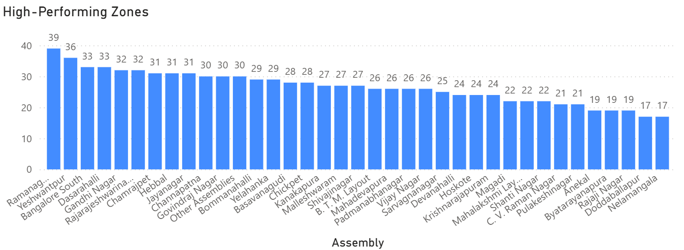
Top Performing Zones
High trip volumes: Ramamurthy Nagar, Bangalore South, BTM Layout
High revenue zones: Yeshwanthpur, Hebbal
Recommendation: Allocate more drivers and targeted promotions in these areas

Slide 5
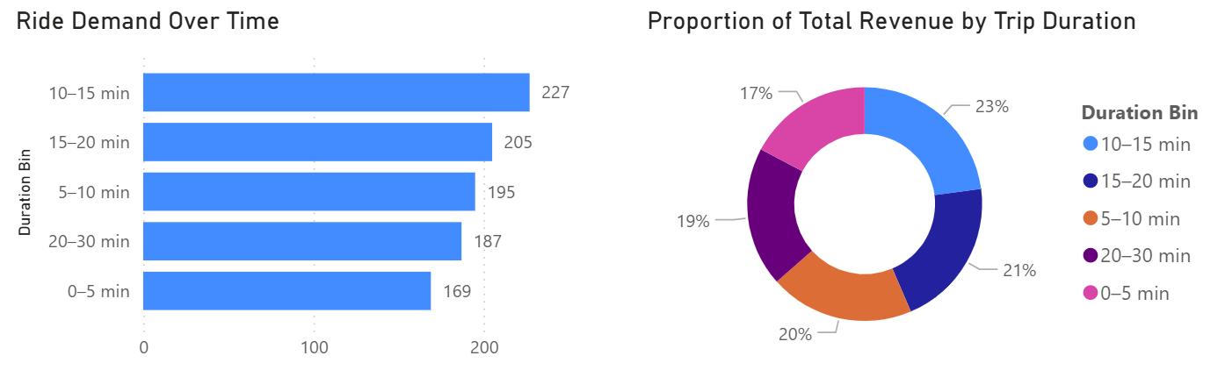
Ride Duration & Revenue Contribution
Mid-duration trips (10–15 mins) are most frequent and profitable
Donut chart of revenue by duration group
Action: Loyalty programs or bundled offers for 10–20 min trips

Slide 6
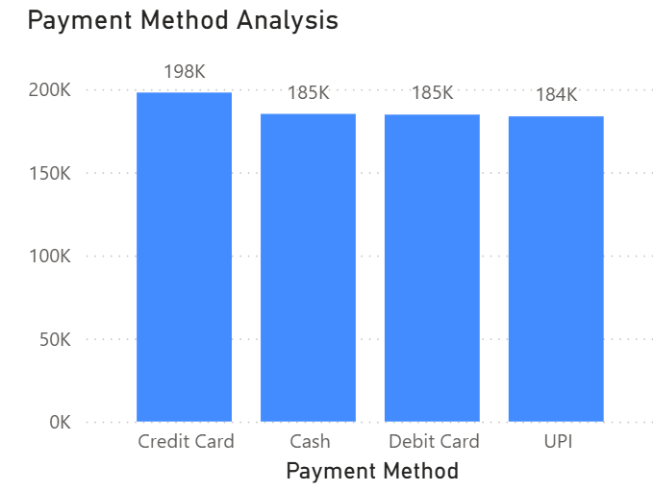
Payment Trends
Most used: Credit card and UPI
Recommendation: Promote digital payments with incentives

Slide 7
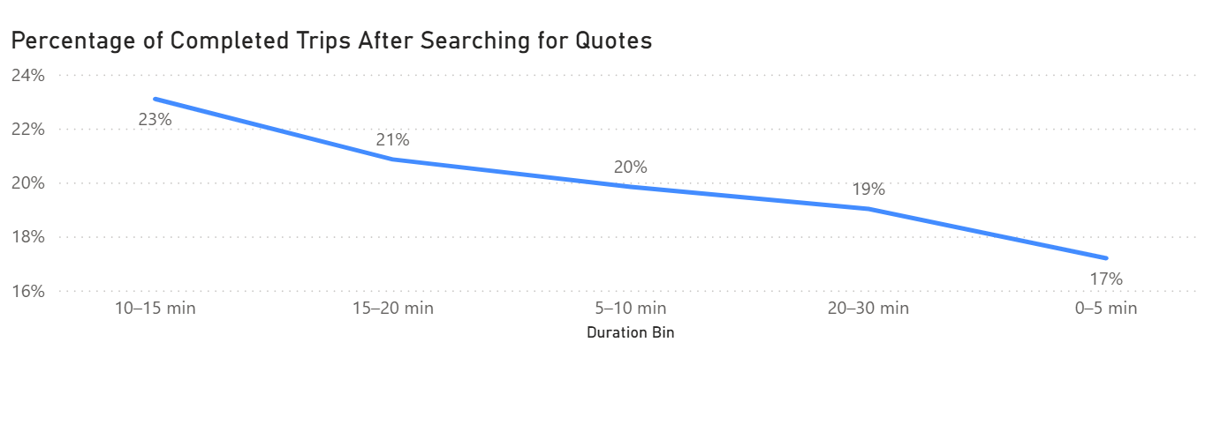
Ride Completion & Cancellations
Completed rides: ~85%
Cancellations mainly by customers
Action: Improve ETA visibility, app experience, and customer support

Slide 8
Strategic Recommendations
Focus resources in high-performing zones
Align driver availability with demand patterns
Encourage mid-duration rides and digital payments

Slide 9
Business Impact & Value
Higher ride completion rates
Revenue growth from targeted zones and promotions
Improved customer satisfaction and retention

Slide 10
Conclusion & Next Steps
Leverage Power BI dashboard for continuous monitoring
1
Implement data-driven strategies for growth
2
Invite management feedback and discussion
3

